Slide 1
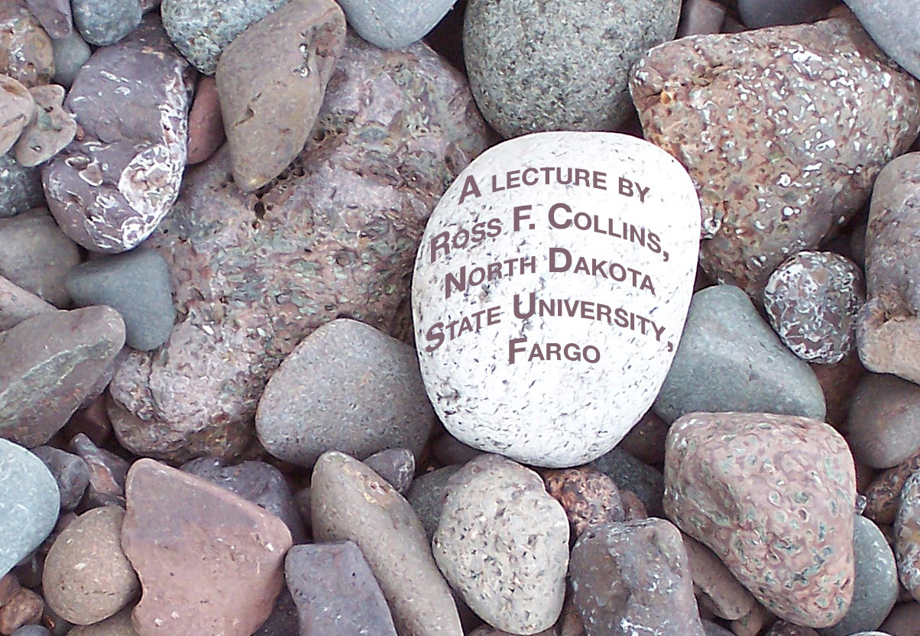
Portfolios
Preparing a professional photojournalism portfolio

Slide 2
Rules for building a portfolio
There are none.
Photo editors disagree, as noted by comments from the National Press Photographers Association contests, as noted by judge Nancy L. Ford.

Slide 3
Rules?
One will say, “Take this photo out.”
The next will say, “Leave this photo in.”
The next will say, “You need more of this.”
The other will say, “You need less of this.”
Another will say, “You need 24 images.” The next, “You need only 12.”

Slide 4
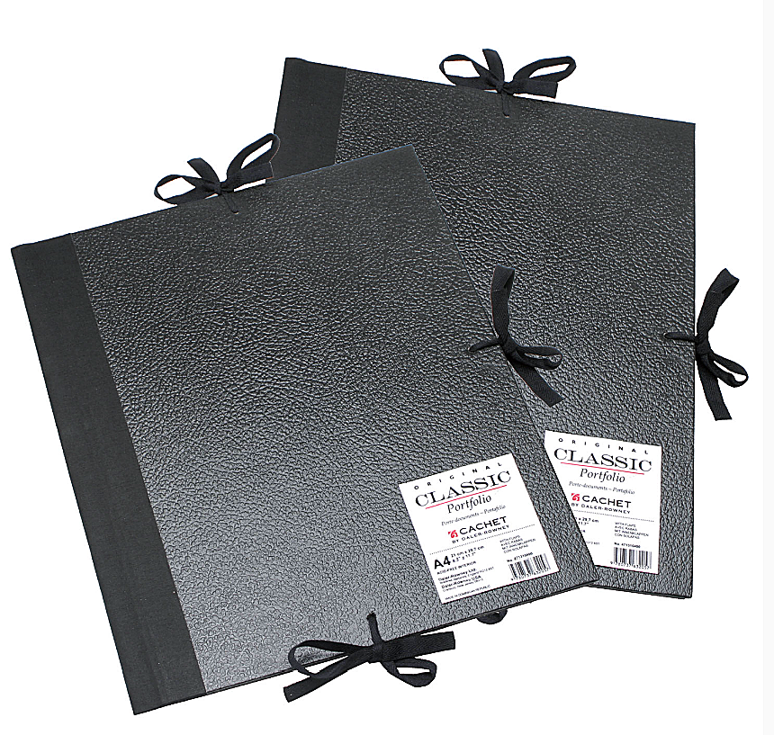
Guidelines
So if we have no actual rules, we do have some pretty clear guidelines regarding what kinds of portfolios attract an editor’s attention.
First, how do we submit our portfolios?

Slide 5
Hard copies
Some editors prefer to see actual photos. These should be carefully prepared in Photoshop and printed high-resolution (300 ppi), in about 8 inch by 10 inch size.
Also usually part of a physical portfolio will be tear sheets—that is, copies of your photos actually published in magazines and newspapers.
More and more photos are published online, but tear sheets still are a way to impress an editor with your demonstrated credentials—usually. Some photo editors do say they don’t care to see clips, just great photos.

Slide 6
CD/DVD
More photo editors now accept your work on a CD.
Make sure yours works in both PC and Mac format.
Usually these are simple jpegs, and not PowerPoint slide shows.

Slide 7
Website
Also more and more acceptable are portfolios on a website. It’s easy to set up a simple website URL bringing an editor directly to your photos.
You may also wish to set up a website slide show. You can do that using Bridge.

Slide 8
How to choose
Photos for your portfolio, as is most obvious, should reflect the best work you can do.
Your entire portfolio will likely be judged by your weakest image. So don’t include any less than your best.

Slide 9
Subjects
Begin by trying to choose a variety of subjects, to show your versatility. Try to find at least one example in each of these categories:
Spot news.
Features.
Sports.
Photo story.
Photo illustration and/or formal portrait.

Slide 10
Critique
It’s best to begin by collecting images you think are worthy, and asking a professional photo editor or teacher to critique your work.
A second person will not have the emotion invested in the image—she won’t care that you waited an hour in the rain and ruined your best hoodie to get the shot. The shot is what matters.
It is hard to face an objective critique, but also a really good way to learn and to choose the best of your images.

Slide 11
Missing categories
Perhaps you really don’t have, say, any truly superb news shots. Should you include one anyway?
The answer is NO. It’s better to have a less balanced portfolio than one with a weak image.
If you are showing your portfolio for a specific type of job, of course, you’ll need to weigh your portfolio to reflect that. For example, a position that likely will require sports photography.

Slide 12
How many?
Most editors expect about 20. If you don’t have 20 strong photos, include fewer.
If you have more than 20, choose the best of the best, and include those.
DON’T send dozens of photos and expect a photo editor to look at all of them. Photo editors receive many portfolios. They don’t have time for that.

Slide 13
Quality
All photos must be carefully edited in Photoshop and/or Camera Raw.
NO blurry photos. If you can’t fix ‘em, chuck ‘em, Unless, of course, it happens to be a really rare and hard-to-get image, like, um, the last living photo of Osama Bin Laden?
NO photos can have an objectionable color cast. If the camera’s white balance didn’t serve, Photoshop’s will have to.
No poorly exposed photos. If you can’t fix ‘em in Photoshop, dump ‘em.
No photos needing cropping. Always carefully crop your work.

Slide 14
Clichés to avoid
Most photo editors have pet peeves, and it’s impossible to predict unless you know about the person you’re sending to. But here are some general clichés to avoid.
Sunsets, unless they really, really are different.
Photos of famous people at, say, a microphone. Don’t feel you need to include a famous person just because you happen to have a photo of one. The photo is what matters.

Slide 15
Photos to avoid
Cute children doing whatever. Pretty much anyone can take pictures of cute kids.
Entertainers performing. Silhouettes of fire fighters with a blaze behind them.
Sports photos without the ball in the photo. In general, it’s tough to compete with the pros for really top-notch photos of major sports. Instead of football, you’ll attract an editor’s attention with a truly great photo of a minor sport, such as soccer, curling, or skateboarding.

Slide 16
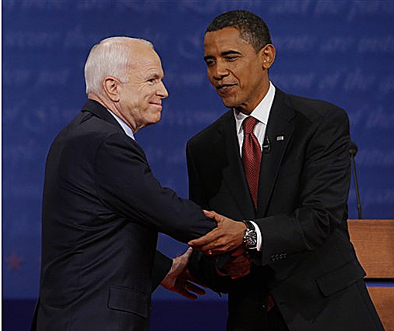
Photos to avoid
It goes without saying you won’t include check-passing, grip and grin, or posed group shots. It doesn’t matter if the person gripping and grinning is the president of the United States. The photo is still bland.

Slide 17
Other clichés
Second-base slides in baseball, “armpit shots” in basketball.
Babies.
Flowers.
Photos from your trip abroad.
Any gimmicky photo, such as one using a star filter, or one of Photoshop’s filters.

Slide 18
What they look for
According to the NPPA, these are aspects editors look for in professional-level photography:
A desire to get out into the world! Photojournalism tells stories about people.
Technical expertise. Photography is a technical, as well as a visual skill. You have to know your camera, know your lighting, and know your image manipulation software.

Slide 19
What they look for
Understanding of photojournalism’s ethical standards. Photojournalists are expected to tell the truth. Photos should not be manipulated.
Photojournalists are expected to have a feeling of public responsibility. If your photos show that you appear irresponsible or insensitive, it will reflect on your character and your credibility.

Slide 20
What they look for
You need an assertive character to be a successful photojournalist.
Photojournalists are often told they can’t take pictures. But the assertive ones try to get around that as much as they can. They tend to be rebels.
That, of course, is moderated by a duty to journalism ethics!

Slide 21
Comments from photo editors
Here are some comments from photo editors regarding portfolios.
“It's important to show the reviewer that you can handle the typical newspaper assignment of news, features and sports. The challenge is to make each and every image in the portfolio ‘sing.’ You make them sing by capturing fleeting moments; by getting a unique angle that no one else sees; by unique composition of elements; by use of different lenses. In this age of visual overload, our job as photojournalists is to surprise the readers. Show them something they didn't expect.”
--Clem Murray, director of photography, The Philadelphia Inquirer.

Slide 22
Comments from photo editors
“I look for style. Photographers who see the world a little differently can shoot the same old thing, but produce pictures that tell wonderful stories in a way I haven't seen before. I like to be surprised by a fresh approach or a different point of view.”
--Curt Chandler, Pittsburgh Post Gazette

Slide 23
Comments from photo editors
What do I like in a portfolio?
Storytelling images. Pictures that have emotion, humor, personality. Good use of foreground and background. Variety.
Compassion. Content. Good use of light, color, patterns and texture. Technical
Quality. Respect for subjects. Style. Risk taking. Surprise.
--Bill Ostendorf, managing editor/visuals, The Providence Journal.

Slide 24
Comments from photo editors
I don't care what you put in, as long as YOU feel is a good representation of your abilities, YOU like it, and YOU are proud of it and YOU think it is acceptable work to be published in a community newspaper. I want to see if you can feel, then photograph and deliver emotion to the reader.
-- Nancy L. Ford, photojournalist/NPPA judge. See: http://www.nlford.com/career/portfolio.shtml#Clem

Slide 25
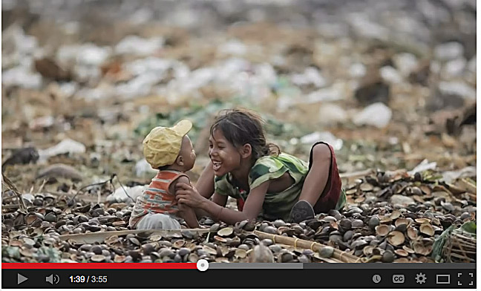
Great photography
This photographer from Reuters news agency gives us tips on how to improve our photojournalism while showing a portfolio of his best work. http://www.youtube.com/watch?v=zsO9IObsaRA

